Slide 1
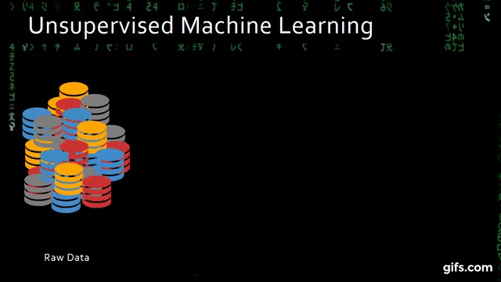
DATA SCIENCE CLUSTERING (UNIT-IV)
MCA 3RD SEMESTER
SIKKIM UNIVERSITY

Slide 2

CONTENT
CLUSTERING
EUCLIDEAN DISTANCE
MANHATTAN DISTANCE
MINKOWSKI DISTANCE
PARTITIONAL
HIERARCHICAL
DENSITY BASED TECHNIQUES
ASSESSMENT METHODS

Slide 3

CLUSTERING

Slide 4
CLUSTERING
When we are working with huge volumes of data, it makes sense to partition the data into logical groups and doing the analysis.
We can use Clustering to make the data into groups with the help of several algorithms like K-Means.
Clustering analysis is a form of exploratory data analysis in which observations are divided into different groups that share common characteristics.
The purpose of cluster analysis (also known as classification) is to construct groups (or classes or clusters) while ensuring the following property: within a group the observations must be as similar as possible (intra-cluster similarity), while observations belonging to different groups must be as different as possible (inter-cluster similarity).
Clustering is the unsupervised learning process of dividing data points into groups such that data points belonging to the same groups have similar features to other data points in the same group and are dissimilar to the data points belonging to different groups.

Slide 5
CLUSTERING
In ideal conditions for clustering to perform well the inter-cluster distance should be very high and intra-cluster distance should be very low.
Based on these two distances we can measure the performance of clustering techniques.
The aim of the clustering process is to discover overall distribution patterns and interesting correlations among the data attributes.
It is the task of grouping a set of objects in such a way that objects in the same group are more similar to each other than to those in other groups.
Cluster analysis itself is not one specific algorithm, but the general task to be solved.
It can be achieved by various algorithms that differ significantly in their understanding of what constitutes a cluster and how to efficiently find them.
Popular notions of clusters include groups with small distances between cluster members, dense areas of the data space, intervals or particular statistical distributions.

Slide 6
CLUSTERING
In terms of unsupervised learning methods, some of the most well researched and common methods can be grouped under clustering.
The basic idea is simple. If you can figure out how to define distances between data points, then data points that are closer together may exhibit some kind of group characteristic we could exploit for modelling or extract new understanding from.
Some examples include patients with similar blood test results that have the same disease, consumers with a similar purchase history that are part of the same socioeconomic class or occupation, and flowers with similar colors and petal lengths that are part of the same species.
Obviously, some of these problems can be solved as classification problems, but this is only possible if the labels are available.
Clustering, as with other unsupervised methods, operate without a label of interest.

Slide 7

Inter-cluster & Intra-cluster

Slide 8
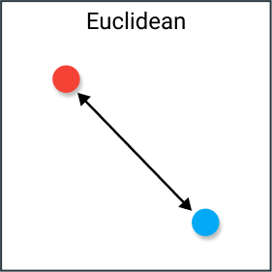
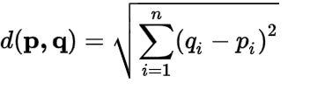
EUCLIDEAN DISTANCE

Slide 9
EUCLIDEAN DISTANCE
Given two data points a and b, we need to find a way to define a distance between them. There are many common distance metrics for vectors of real numbers.
The most common one is of course the Euclidean distance, which simply considers the points a and b as the furthest vertices of a right triangle and takes the hypotenuse of the triangle as the distance.
There are different pros and cons of using Euclidean distance as a metric.
On the positive side, most optimization methods are designed with Euclidean distance in mind and the computational costs can be well constrained.
Euclidean distance is graphically straightforward and well understood by most people.
On the negative side, the fact that we’re squaring distances significantly amplifies the effect of outliers.
For two vectors a,b, the vectorized Euclidean Distance is found by taking the difference of pairs of coordinates of a,b, squaring the results, summing them, and taking the square root.

Slide 10
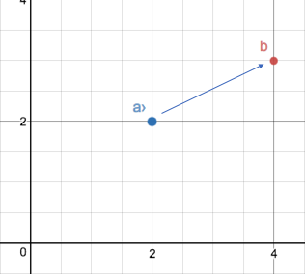
EUCLIDEAN DISTANCE

Slide 11
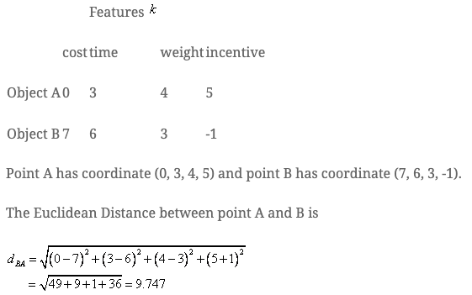
EUCLIDEAN DISTANCE (EXAMPLE)

Slide 12
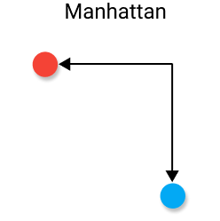
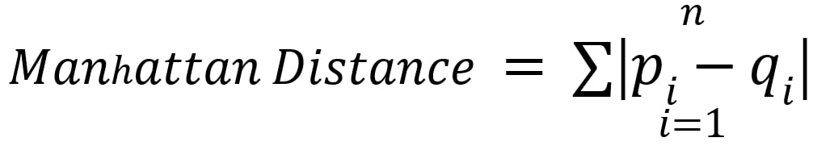
manhattan DISTANCE

Slide 13
manhattan DISTANCE
Consider now if we’re trying to find the distance, we’d have to walk to get between two buildings in Manhattan that are several blocks apart.
Since the sidewalks are parallel, we can’t simply cut diagonally from one building to another, so the Euclidean Distance wouldn’t give us a realistic estimate for the distance.
We have to imagine traversing along a grid where the two points are on vertices.
This is equivalent to putting the two points on diagonal vertices of a square and taking the distance to be half the perimeter.
This metric goes by many names including absolute value, Manhattan, City Block Distance and Taxicab distance.
It is found by taking the absolute value between pairs of coordinates in a,b and summing them.
Optimization algorithms in Manhattan distance are often more computationally expensive and complex but are significantly more resistant to outliers.

Slide 14
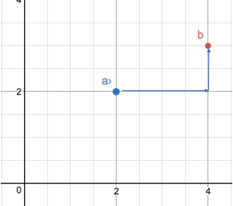
manhattan DISTANCE

Slide 15
manhattan DISTANCE (EXAMPLE)
n = 4
point1 = { -1, 5 }
point2 = { 1, 6 }
point3 = { 3, 5 }
point4 = { 2, 3 }
Distance of { 1, 6 }, { 3, 5 }, { 2, 3 } from { -1, 5 } are 3, 4, 5 respectively.
Therefore, sum = 3 + 4 + 5 = 12
Distance of { 3, 5 }, { 2, 3 } from { 1, 6 } are 3, 4 respectively.
Therefore, sum = 12 + 3 + 4 = 19
Distance of { 2, 3 } from { 3, 5 } is 3.
Therefore, sum = 19 + 3 = 22.

Slide 16
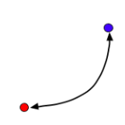
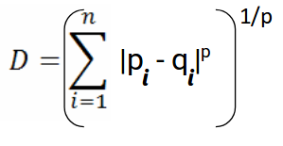
mINKOWSKI DISTANCE

Slide 17
mINKOWSKI DISTANCE
Minkowski distance is a distance measured between two points in N-dimensional space.
It is widely used in the field of Machine learning, especially in the concept to find the optimal correlation or classification of data.
The Minkowski distance is a generalization of the Manhattan and Euclidean distances that adds a parameter p called order.

Slide 18
mINKOWSKI DISTANCE
The Minkowski distance between two variabes X and Y is defined as:
The case where p = 1 is equivalent to the Manhattan distance and the case where p = 2 is equivalent to the Euclidean distance.
Although p can be any real value, it is typically set to a value between 1 and 2.
For values of p less than 1, the formula above does not define a valid distance metric since the triangle inequality is not satisfied.

Slide 19
mINKOWSKI DISTANCE
Mathematically:
Given two points p and q with coordinates (p₁, p₂, … , p_{n}) and (q₁, q₂, … , q_{n}) and an order p, the Minkowski distance between both vectors are defined as:
Where |x| represents the norm of vector x.
Properties:
Positivity : d(p,q) > 0 if p ≠q and d(p,p) = 0.
Symmetry : d(p,q) = d(q,p).
Triangle inequality : d(p,q) ≤ d(p,r) + d(r,q).
A distance that satisfies these properties is a metric.
Thus, the Minkowski distance is a metric for n ≥ 1, but not when n <1 because the triangle inequality is not valid in this case.

Slide 20
mINKOWSKI DISTANCE (EXAMPLE)
Let us consider a 2-dimensional space having three points
P₁ (X₁, Y₁), P₂ (X₂, Y₂), and P₃ (X_{3,} Y₃)
The Minkowski distance is given by:
( |X₁ – Y₁|^{p} + |X₂ – Y₂|^{p} + |X₂ – Y₂|^{p} )^{1/p}
We are given two vectors, vect1 as (4, 2, 6, 8) and vect2 as (5, 1, 7, 9).
Their Minkowski distance for p = 2 is given by,
( |4 – 5|² + |2 – 1|² + |6 – 7|² + |8 – 9|² )^{1/2}
which is equal to 2.

Slide 21
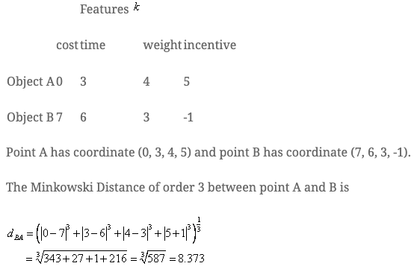
mINKOWSKI DISTANCE (EXAMPLE)

Slide 22
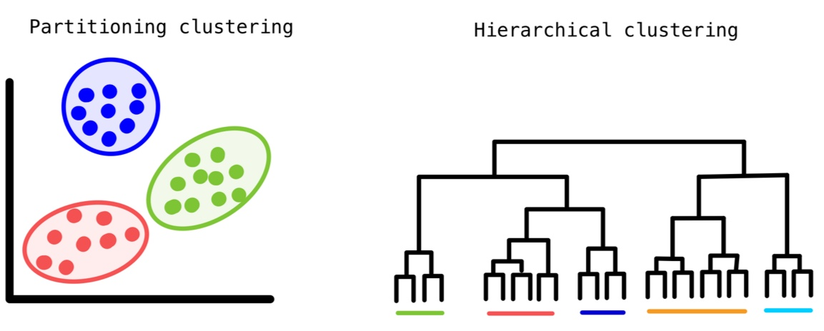
PARTITIONAL

Slide 23
PARTITIONING
This clustering method classifies the information into multiple groups based on the characteristics and similarity of the data.
Its the data analysts to specify the number of clusters that has to be generated for the clustering methods.
In the partitioning method when database(D) that contains multiple(N) objects then the partitioning method constructs user-specified(K) partitions of the data in which each partition represents a cluster and a particular region.
There are many algorithms that come under partitioning method some of the popular ones are K-Mean, PAM(K-Mediods), CLARA algorithm (Clustering Large Applications) etc.

Slide 24
PARTITIONING
Clustering aims to seek a partition of the data in the same homogenous clusters.
This homogeneity and finding the exact clustering are evaluated only by using criterion functions.
One of the most popular techniques of the criterion function is the summing of squared-error (SSE) criterion and similar methods are used such as mean-square-error (MSE), normalized mean-square-error (NMSE), and so on.
Given a database of n objects or data tuples, a partitioning method constructs k partitions of the data, where each partition represents a cluster and k <= n.
That is, it classifies the data into k groups, which together satisfy the following requirements
Each group must contain at least one object,
Each object must belong to exactly one group.

Slide 25
PARTITIONING
Given k, the number of partitions to construct, a partitioning method creates an initial partition.
It uses iterative relocation technique that attempts to improve the partitioning by moving objects from one group to another.
The general criterion of a good partitioning is that objects in the same cluster are “close” or related to each other, whereas objects of different clusters are “far apart” or very different.
There are various kinds of other criteria for judging the quality of partitions.
To achieve global optimality in partitioning – based clustering it would require the continuous evaluation of all the possible partitions.
The k-means algorithm is an example, where each cluster is represented by the mean value of the objects in the cluster.

Slide 26
pARTITION METHODS
Center-based
A cluster is a set of objects such that an object in a cluster is closer (more similar) to the “center” of a cluster, than to the center of any other cluster.
The center of a cluster is called centroid.
Each point is assigned to the cluster with the closest centroid.
The number of clusters usually should be specified.

Slide 27
pARTITION METHODS (K-MEANS)
K-means
Partition {x1 ,…,xn } into K clusters
K is predefined
Initialization
Specify the initial cluster centers (centroids)
• Iteration until no change
– For each object xi
• Calculate the distances between xi and the K centroids
• (Re)assign xi to the cluster whose centroid is the closest to xi
– Update the cluster centroids based on current assignment

Slide 28
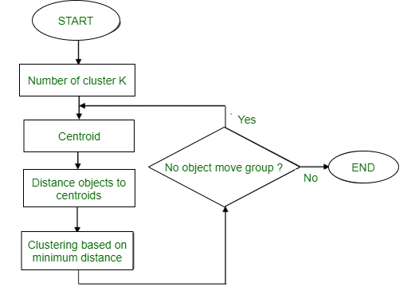
K-means
Method
Randomly assign K objects from the dataset(D) as cluster centres(C)
(Re) Assign each object to which object is most similar based upon mean values.
Update Cluster means, i.e., Recalculate the mean of each cluster with the updated values.
Repeat Step 4 until no change occurs.

Slide 29
K-means (example)
Suppose we want to group the visitors to a website using just their age as follows:
16, 16, 17, 20, 20, 21, 21, 22, 23, 29, 36, 41, 42, 43, 44, 45, 61, 62, 66
Initial Cluster:
K=2
Centroid(C1) = 16 [16]
Centroid(C2) = 22 [22]
Note: These two points are chosen randomly from the dataset.

Slide 30
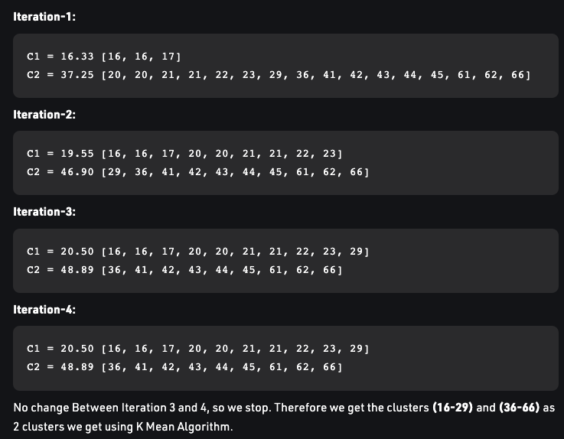
K-means (example)

Slide 31
HIERARCHICAL

Slide 32
HIERARCHICAL CLUSTERING
A Hierarchical clustering method works via grouping data into a tree of clusters. Hierarchical clustering begins by treating every data point as a separate cluster. Then, it repeatedly executes the subsequent steps:
Identify the 2 clusters which can be closest together, and
Merge the 2 maximum comparable clusters. We need to continue these steps until all the clusters are merged together.
In Hierarchical Clustering, the aim is to produce a hierarchical series of nested clusters
A diagram called Dendrogram (A Dendrogram is a tree-like diagram that statistics the sequences of merges or splits) graphically represents this hierarchy and is an inverted tree that describes the order in which factors are merged (bottom-up view) or clusters are broken up (top-down view).

Slide 33
HIERARCHICAL CLUSTERING
The hierarchical clustering technique has two approaches:
Agglomerative:
Agglomerative is a bottom-up approach, in which the algorithm starts with taking all data points as single clusters and merging them until one cluster is left.
Divisive:
Divisive algorithm is the reverse of the agglomerative algorithm as it is a top-down approach.
As we have seen in the K-means clustering that there are some challenges with this algorithm, which are a predetermined number of clusters, and it always tries to create the clusters of the same size.
To solve these two challenges, we can opt for the hierarchical clustering algorithm because, in this algorithm, we don't need to have knowledge about the predefined number of clusters.

Slide 34
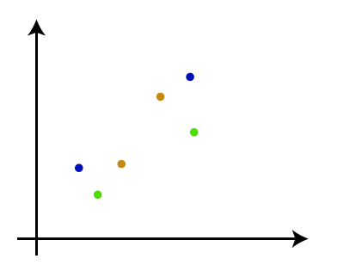
AGGLOMERATIVE HIERARCHICAL CLUSTERING
The working of the AHC algorithm can be explained using the below steps:
Step-1: Create each data point as a single cluster. Let's say there are N data points, so the number of clusters will also be N.

Slide 35
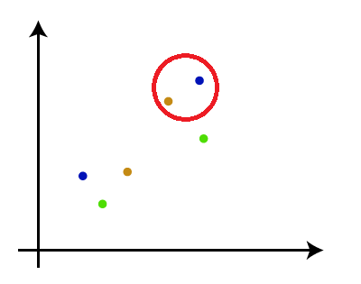
AGGLOMERATIVE HIERARCHICAL CLUSTERING
Step-2:
Two closest data points or clusters and merge them to form one cluster.
So, there will now be N-1 clusters.

Slide 36
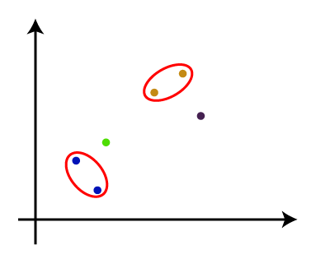
AGGLOMERATIVE HIERARCHICAL CLUSTERING
Step-3:
Again, take the two closest clusters and merge them together to form one cluster.
There will be N-2 clusters.

Slide 37
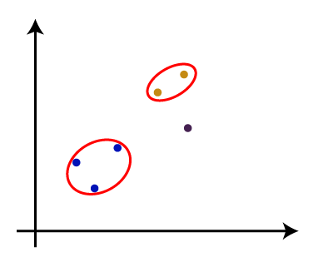
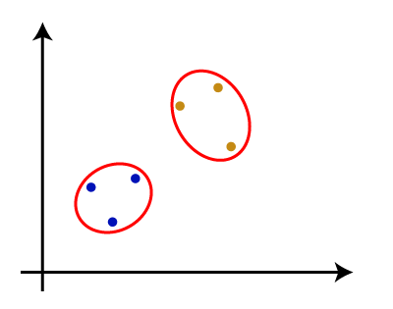
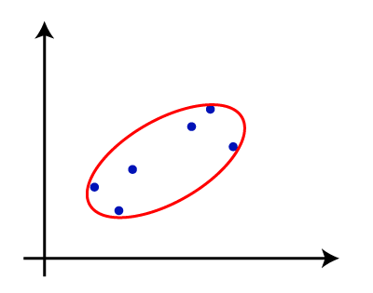
AGGLOMERATIVE HIERARCHICAL CLUSTERING
Step-4:
Repeat Step 3 until only one cluster left. So, we will get the following clusters. Consider the images shown in this slide
Step-5: Once all the clusters are combined into one big cluster, develop the dendrogram to divide the clusters as per the problem.

Slide 38
AGGLOMERATIVE HIERARCHICAL CLUSTERING
Algorithm:
Calculate the similarity of one cluster with all the other clusters (calculate proximity matrix).
Consider every data point as an individual cluster.
Merge the clusters which are highly similar or close to each other.
Recalculate the proximity matrix for each cluster.
Repeat Steps 3 and 4 until only a single cluster remains.

Slide 39
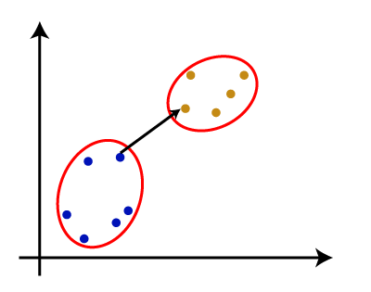
MEASURE FOR THE DISTANCE BETWEEN TWO CLUSTERS
As we have seen, the closest distance between the two clusters is crucial for the hierarchical clustering.
There are various ways to calculate the distance between two clusters, and these ways decide the rule for clustering.
These measures are called Linkage methods. Some of the popular linkage methods are given below:
Single Linkage: It is the Shortest Distance between the closest points of the clusters. Consider the image shown here.

Slide 40
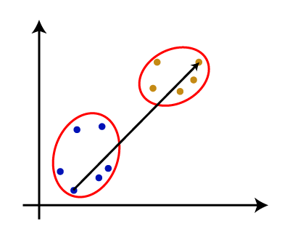
MEASURE FOR THE DISTANCE BETWEEN TWO CLUSTERS
2. Complete Linkage: It is the farthest distance between the two points of two different clusters.
It is one of the popular linkage methods as it forms tighter clusters than single-linkage.
3. Average Linkage: It is the linkage method in which the distance between each pair of datasets is added up and then divided by the total number of datasets to calculate the average distance between two clusters.
It is also one of the most popular linkage methods.
Complete Linkage

Slide 41
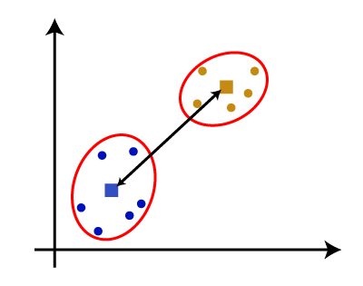
MEASURE FOR THE DISTANCE BETWEEN TWO CLUSTERS
Centroid Linkage:
It is the linkage method in which the distance between the centroid of the clusters is calculated. Consider the image shown here.

Slide 42
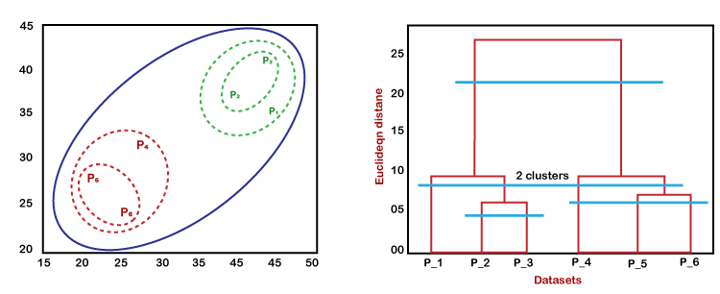
WORKING OF DENDROGRAM IN HIERARCHICAL CLUSTERING
The dendrogram is a tree-like structure that is mainly used to store each step as a memory that the HC algorithm performs.
In the dendrogram plot, the Y-axis shows the Euclidean distances between the data points, and the x-axis shows all the data points of the given dataset.
The working of the dendrogram can be explained using the diagrams shown here.
In the above diagram, the left part is showing how clusters are created in agglomerative clustering, and the right part is showing the corresponding dendrogram.

Slide 43
WORKING OF DENDROGRAM IN HIERARCHICAL CLUSTERING
As we have discussed above, firstly, the datapoints P2 and P3 combine together and form a cluster, correspondingly a dendrogram is created, which connects P2 and P3 with a rectangular shape.
The hight is decided according to the Euclidean distance between the data points.
In the next step, P5 and P6 form a cluster, and the corresponding dendrogram is created.
It is higher than of previous, as the Euclidean distance between P5 and P6 is a little bit greater than the P2 and P3.
Again, two new dendrograms are created that combine P1, P2, and P3 in one dendrogram, and P4, P5, and P6, in another dendrogram.
At last, the final dendrogram is created that combines all the data points together.
NOTE: We can cut the dendrogram tree structure at any level as per our requirement.

Slide 44
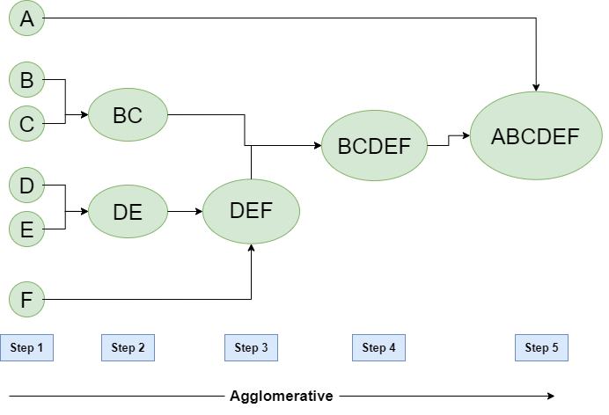
AGGLOMERATIVE HIERARCHICAL CLUSTERING
Let’s see the graphical representation of this algorithm using a dendrogram.
Note:
This is just a demonstration of how the actual algorithm works no calculation has been performed below all the proximity among the clusters is assumed.
Let’s say we have six data points A, B, C, D, E, and F.

Slide 45
AGGLOMERATIVE HIERARCHICAL CLUSTERING
Step-1: Consider each alphabet as a single cluster and calculate the distance of one cluster from all the other clusters.
Step-2: In the second step comparable clusters are merged together to form a single cluster. Let’s say cluster (B) and cluster (C) are very similar to each other therefore we merge them in the second step similarly to cluster (D) and (E) and at last, we get the clusters [(A), (BC), (DE), (F)]
Step-3: We recalculate the proximity according to the algorithm and merge the two nearest clusters([(DE), (F)]) together to form new clusters as [(A), (BC), (DEF)]
Step-4: Repeating the same process; The clusters DEF and BC are comparable and merged together to form a new cluster. We’re now left with clusters [(A), (BCDEF)].
Step-5: At last, the two remaining clusters are merged together to form a single cluster [(ABCDEF)].

Slide 46
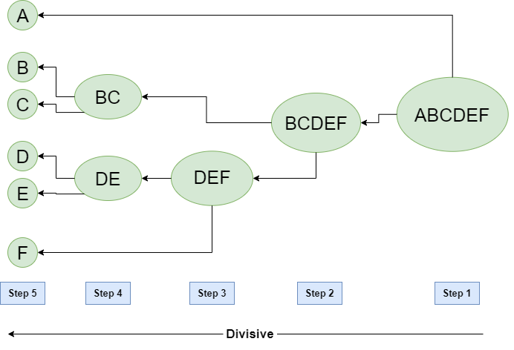
DIVISIVE HIERARCHICAL CLUSTERING
We can say that the Divisive Hierarchical clustering is precisely the opposite of the Agglomerative Hierarchical clustering.
In Divisive Hierarchical clustering, we take into account all of the data points as a single cluster and in every iteration, we separate the data points from the clusters which aren’t comparable.
In the end, we are left with N clusters.

Slide 47
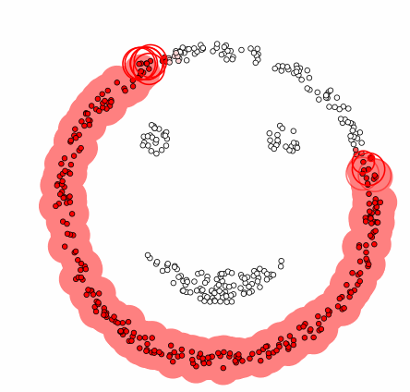
DENSITY BASED clustering TECHNIQUES

Slide 48
DENSITY BASED clustering TECHNIQUES
Density-based clustering refers to a method that is based on local cluster criterion, such as density connected points.
Density-Based Clustering refers to one of the most popular unsupervised learning methodologies used in model building and machine learning algorithms.
The data points in the region separated by two clusters of low point density are considered as noise.
The surroundings with a radius ε of a given object are known as the ε neighborhood of the object.
If the ε neighborhood of the object comprises at least a minimum number, MinPts of objects, then it is called a core object.

Slide 49
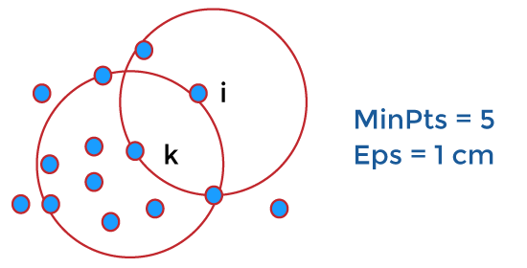
DENSITY BASED clustering TECHNIQUES
There are two different parameters to calculate the density-based clustering.
E_{PS}: It is considered as the maximum radius of the neighborhood.
MinPts: MinPts refers to the minimum number of points in an Eps neighborhood of that point.
NEps (i) : { k belongs to D and dist (i,k) < = Eps}
Directly density reachable:
A point i is considered as the directly density reachable from a point k with respect to Eps, MinPts if
i belongs to NEps(k)
Core point condition:
NEps (k) >= MinPts

Slide 50
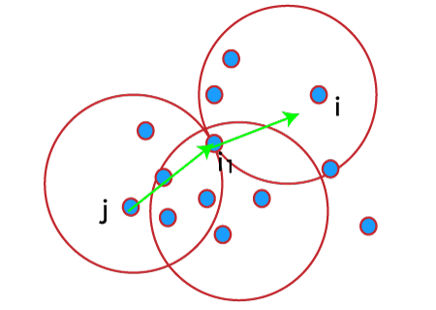
DENSITY BASED clustering TECHNIQUES
A point denoted by i is a density reachable from a point j with respect to Eps, MinPts if there is a sequence chain of a point
i1,…., in, i1 = j, pn = i
such that,
i_{i} + 1 is directly density reachable from i_{i.}

Slide 51
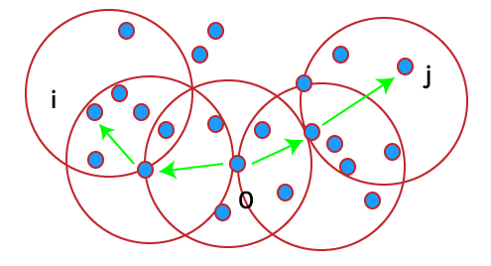
DENSITY BASED clustering TECHNIQUES
Density connected:
A point i refers to density connected to a point j with respect to Eps, MinPts if there is a point o such that both i and j are considered as density reachable from o with respect to Eps and MinPts.

Slide 52
WORKING OF DENSITY-BASED CLUSTERING
Suppose a set of objects is denoted by D', we can say that an object I is directly density reachable form the object j only if it is located within the ε neighborhood of j, and j is a core object.
An object i is density reachable form the object j with respect to ε and MinPts in a given set of objects, D' only if there is a sequence of object chains point i1,…., in, i1 = j, pn = i such that i_{i} + 1 is directly density reachable from i_{i} with respect to ε and MinPts.
An object i is density connected object j with respect to ε and MinPts in a given set of objects, D' only if there is an object o belongs to D such that both point i and j are density reachable from o with respect to ε and MinPts.

Slide 53
Major Features of Density-Based Clustering
The primary features of Density-based clustering are given below.
It is a scan method.
It requires density parameters as a termination condition.
It is used to manage noise in data clusters.
Density-based clustering is used to identify clusters of arbitrary size

Slide 54
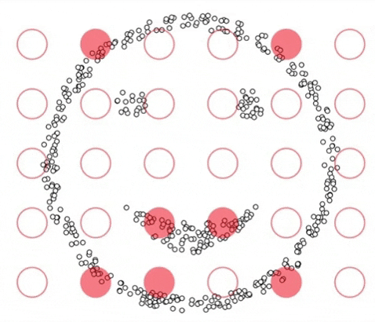
Density-based spatial clustering of applications with noise (DBSCAN)

Slide 55
Density-based spatial clustering of applications with noise (DBSCAN)
K-Means and Hierarchical Clustering both fail in creating clusters of arbitrary shapes.
They are not able to form clusters based on varying densities.
That’s why we need DBSCAN clustering.
DBSCAN works on the assumption that clusters are dense regions in space separated by regions of lower density.
It groups ‘densely grouped’ data points into a single cluster.
It can identify clusters in large spatial datasets by looking at the local density of the data points.
The most exciting feature of DBSCAN clustering is that it is robust to outliers.

Slide 56
Density-based spatial clustering of applications with noise (DBSCAN)
It also does not require the number of clusters to be told beforehand, unlike K-Means, where we have to specify the number of centroids.
DBSCAN requires only two parameters: epsilon and minPoints.
Epsilon is the radius of the circle to be created around each data point to check the density and minPoints is the minimum number of data points required inside that circle for that data point to be classified as a Core point.
In higher dimensions the circle becomes hypersphere, epsilon becomes the radius of that hypersphere, and minPoints is the minimum number of data points required inside that hypersphere.
DBSCAN is not just able to cluster the data points correctly, but it also perfectly detects noise in the dataset.

Slide 57
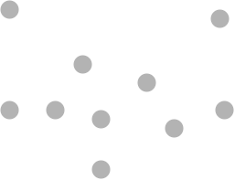
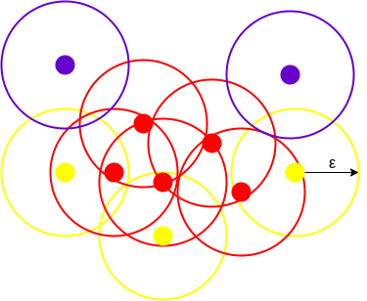
WORKING OF DBSCAN
Here, we have some data points represented by grey color (Top figure).
DBSCAN creates a circle of epsilon radius around every data point and classifies them into Core point, Border point, and Noise (Bottom figure).
A data point is a Core point if the circle around it contains at least ‘minPoints’ number of points.
If the number of points is less than minPoints, then it is classified as Border Point, and if there are no other data points around any data point within epsilon radius, then it treated as Noise.

Slide 58
WORKING OF DBSCAN
The figure shows us a cluster created by DBCAN with minPoints = 3. Here, we draw a circle of equal radius epsilon around every data point.
These two parameters help in creating spatial clusters.
All the data points with at least 3 points in the circle including itself are considered as Core points represented by red color.
All the data points with less than 3 but greater than 1 point in the circle including itself are considered as Border points. They are represented by yellow color.

Slide 59
WORKING OF DBSCAN
Finally, data points with no point other than itself present inside the circle are considered as Noise represented by the purple colour.
For locating data points in space, DBSCAN uses Euclidean distance, although other methods can also be used (like great circle distance for geographical data).
It also needs to scan through the entire dataset once, whereas in other algorithms we have to do it multiple times.

Slide 60
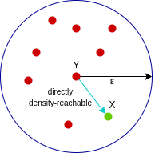
WORKING OF DBSCAN
These are the two concepts in DBSCAN that you need to understand. Reachability states if a data point can be accessed from another data point directly or indirectly, whereas Connectivity states whether two data points belong to the same cluster or not. In terms of reachability and connectivity, two points in DBSCAN can be referred to as:
Directly Density-Reachable
Density-Reachable
Density-Connected
A point X is directly density-reachable from point Y w.r.t epsilon,
minPoints if,
X belongs to the neighborhood of Y, i.e, dist(X, Y) <= epsilon
Y is a core point
Here, X is directly density-reachable from Y, but vice versa is not valid.

Slide 61
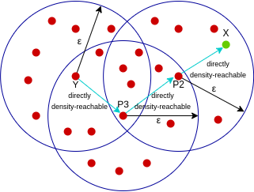
WORKING OF DBSCAN
A point X is density-reachable from point Y w.r.t epsilon, minPoints if there is a chain of points p1, p2, p3, …, pn and p1=X and pn=Y such that pi+1 is directly density-reachable from pi.
Here, X is density-reachable from Y with X being directly density-reachable from P2, P2 from P3, and P3 from Y.
But the inverse of this is not valid.

Slide 62
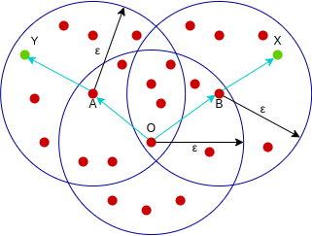
WORKING OF DBSCAN
A point X is density-connected from point Y w.r.t epsilon and minPoints if there exists a point O such that both X and Y are density-reachable from O w.r.t to epsilon and minPoints.
Here, both X and Y are density-reachable from O, therefore, we can say that X is density-connected from Y.

Slide 63
WORKING OF DBSCAN
Parameter Selection in DBSCAN Clustering
DBSCAN is very sensitive to the values of epsilon and minPoints.
Therefore, it is very important to understand how to select the values of epsilon and minPoints.
A slight variation in these values can significantly change the results produced by the DBSCAN algorithm.
The value of minPoints should be at least one greater than the number of dimensions of the dataset, i.e.,
minPoints>=Dimensions+1.

Slide 64
WORKING OF DBSCAN
Parameter Selection in DBSCAN Clustering
It does not make sense to take minPoints as 1 because it will result in each point being a separate cluster. Therefore, it must be at least 3.
Generally, it is twice the dimensions.
But domain knowledge also decides its value.
The value of epsilon can be decided from the K-distance graph.
The point of maximum curvature (elbow) in this graph tells us about the value of epsilon.
If the value of epsilon chosen is too small then a higher number of clusters will be created, and more data points will be taken as noise.
Whereas, if chosen too big then various small clusters will merge into a big cluster, and we will lose details.

Slide 65

Algorithmic steps for DBSCAN clustering
The algorithm proceeds by arbitrarily picking up a point in the dataset (until all points have been visited).
If there are at least ‘minPoint’ points within a radius of ‘ε’ to the point then we consider all these points to be part of the same cluster.
The clusters are then expanded by recursively repeating the neighborhood calculation for each neighboring point.

Slide 66
Parameter Estimation
For DBSCAN, the parameters ε and minPts are needed.
minPts: As a rule of thumb, a minimum minPts can be derived from the number of dimensions D in the data set, as minPts ≥ D + 1.
The low value minPts = 1 does not make sense, as then every point on its own will already be a cluster.
With minPts ≤ 2, the result will be the same as of hierarchical clustering with the single link metric, with the dendrogram cut at height ε.
Therefore, minPts must be chosen at least 3.
However, larger values are usually better for data sets with noise and will yield more significant clusters.
As a rule of thumb, minPts = 2·dim can be used, but it may be necessary to choose larger values for very large data, for noisy data or for data that contains many duplicates.

Slide 67
Parameter Estimation
ε: The value for ε can then be chosen by using a k-distance graph, plotting the distance to the k = minPts-1 nearest neighbor ordered from the largest to the smallest value.
Good values of ε are where this plot shows an “elbow”: if ε is chosen much too small, a large part of the data will not be clustered; whereas for a too high value of ε, clusters will merge and the majority of objects will be in the same cluster.
In general, small values of ε are preferable, and as a rule of thumb, only a small fraction of points should be within this distance of each other.
Distance function: The choice of distance function is tightly linked to the choice of ε, and has a major impact on the outcomes. In general, it will be necessary to first identify a reasonable measure of similarity for the data set, before the parameter ε can be chosen.
There is no estimation for this parameter, but the distance functions need to be chosen appropriately for the data set.

Slide 68
PROS & CONS OF DBSCAN
Pros
The DBSCAN is better than other cluster algorithms because it does not require a pre-set number of clusters.
It identifies outliers as noise, unlike the Mean-Shift method that forces such points into the cluster in spite of having different characteristics.
It finds arbitrarily shaped and sized clusters quite well.
Cons
It is not very effective when you have clusters of varying densities. There is a variance in the setting of the distance threshold Ɛ and the minimum points for identifying the neighborhood when there is a change in the density levels.
If you have high dimensional data, the determining of the distance threshold Ɛ becomes a challenging task.

Slide 69
DBSCAN Vs K-means Clustering
S. No. | K-means Clustering | DBSCAN
1 | Distance based clustering | Density based clustering
2 | Every observation becomes a part of some cluster eventually | Clearly separates outliers and clusters observations in high density areas
3 | Build clusters that have a shape of a hypersphere | Build clusters that have an arbitrary shape or clusters within clusters.
4 | Sensitive to outliers | Robust to outliers
5 | Require no. of clusters as input | Doesn’t require no. of clusters as input

Slide 70

ASSESSMENT METHODS

Slide 71
ASSESSMENT METRICS FOR CLUSTERING ALGORITHMS
Assessing the quality of your model is one of the most important considerations when deploying any machine learning algorithm.
For supervised learning problems, this is easy. There are already labels for every example, so the practitioner can test the model’s performance on a reserved evaluation set.
We don’t have that luxury when we’re dealing with unlabelled data in unsupervised learning contexts. There’s nothing to even test since there’s no ground truth.
However, numerous metrics examine the quality of clustering results when labelled data is unavailable.
These metrics can give the practitioner insight into how the clusters might change depending on the algorithm’s selection and the natural tendency of the data to group together.
These metrics do not measure the validity of the model’s predictions. Instead, the metrics evaluate the comparative performance of models against each other in terms of some heuristic metric.

Slide 72
ASSESSMENT METRICS FOR CLUSTERING ALGORITHMS
Some of the internal measures that can be deployed on clustering algorithms to measure the relative quality of different models are:
Davies-Bouldin Index
Dunn Index
Silhouette Coefficient

Slide 73
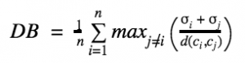
ASSESSMENT METRICS FOR CLUSTERING ALGORITHMS
DAVIES-BOULDIN (DB) INDEX
The DB Index is calculated by the following formula:
where n is the number of clusters and σi is the average distance of all points in cluster i from the cluster centroid ci.
The DB index captures the intuition that clusters that are (1) well-spaced from each other and (2) themselves very dense are likely a ‘good’ clustering.
This is because the measure’s ‘max’ statement repeatedly selects the values where the average point is farthest away from its centroid, and where the centroids are closest together.
As the DB index shrinks, the clustering is considered ‘better’.

Slide 74
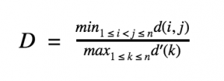
ASSESSMENT METRICS FOR CLUSTERING ALGORITHMS
Dunn Index
The formula for the Dunn Index is as follows:
where i, j and k are each indices for clusters, d measures the inter-cluster distance and d’ measures the intra-cluster difference.
The Dunn Index captures the same idea as the DB Index: it gets better when clusters are well-spaced and dense. But the Dunn Index increases as performance improves.
What differs is the way this problem is approached.
While the DB index considers the dispersion and separation of all clusters, the Dunn Index only considers the worst cases in the clustering: the clusters that are closest together and the single most dispersed cluster.
Depending on your application, the change in objective may introduce unexpected problems.
It’s really up to you which of the two approaches to work with.

Slide 75
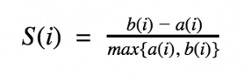
ASSESSMENT METRICS FOR CLUSTERING ALGORITHMS
Silhouette Coefficient
The Silhouette Coefficient is measured like so:
where a(i) is the average distance of point i from all other points in its cluster and b(i) is the smallest average distance of i to all points in any other cluster.
To clarify, b(i) is found by measuring the average distance of i from every point in cluster A, the average distance of i from every point in cluster B, and taking the smallest resulting value.

Slide 76
ASSESSMENT METRICS FOR CLUSTERING ALGORITHMS
Silhouette Coefficient
The Silhouette Coefficient tells us how well-assigned each individual point is.
If S(i) is close to 0, it is right at the inflection point between two clusters. If it is closer to -1, then we would have been better off assigning it to the other cluster. If S(i) is close to 1, then the point is well-assigned and can be interpreted as belonging to an ‘appropriate’ cluster.
The Silhouette Coefficient is a very intuitive and sophisticated measure of distance.
Its downfall is that it can be extremely expensive to compute on all n points. This is because we must compute the distance of i from all other n — 1 points for each i, which leads to a complexity of O(n2).

